Slide 1
RETAIL ANALYTICS CASE STUDY
A MySQL Project

Slide 2
Business Problem
The retail company has observed stagnant growth and declining customer engagement metrics over the past quarters. Initial assessments indicate potential issues in product performance variability, ineffective customer segmentation, and lack of insights into customer purchasing behavior. The company seeks to leverage its sales transaction data, customer profiles, and product inventory information to address the following key business problems:
Product Performance Variability: Identifying which products are performing well in terms of sales and which are not. This insight is crucial for inventory management and marketing focus.
Customer Segmentation: The company lacks a clear understanding of its customer base segmentation. Effective segmentation is essential for targeted marketing and enhancing customer satisfaction.
Customer Behavior Analysis: Understanding patterns in customer behavior, including repeat purchases and loyalty indicators, is critical for tailoring customer engagement strategies and improving retention rates.

Slide 3
Problem 1: Remove Duplicates
Write a query to identify the number of duplicates in "sales_transaction" table. Also, create a separate table containing the unique values and remove the original table from the databases and replace the name of the new table with the original name.

Slide 4
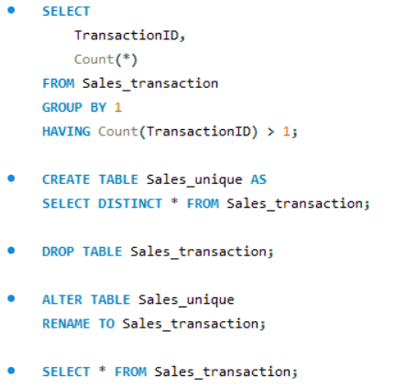
Solution:

Slide 5
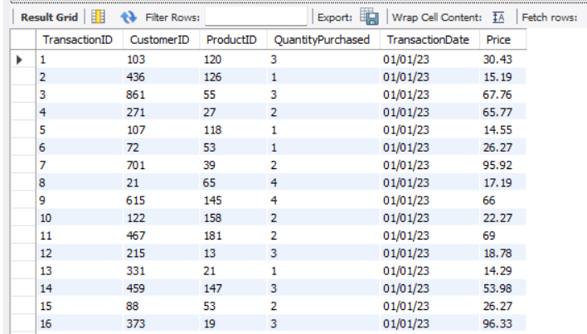
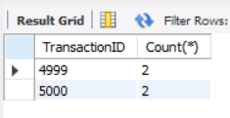
Output:

Slide 6
Insights Drawn:
Detecting duplicate TransactionIDs highlights data quality issues that can affect sales accuracy.
Creating a unique-only table ensures the data is clean, consistent, and reliable for reporting.
Removing duplicates prevents inflated figures and misleading analytics.
Replacing the old table with the cleaned version preserves database integrity without disrupting existing reports.
The approach provides a repeatable workflow for improving data governance across other tables.

Slide 7
Problem 2: Fix Incorrect Prices
Write a query to identify the discrepancies in the price of the same product in "sales_transaction" and "product_inventory" tables. Also, update those discrepancies to match the price in both the tables.

Slide 8
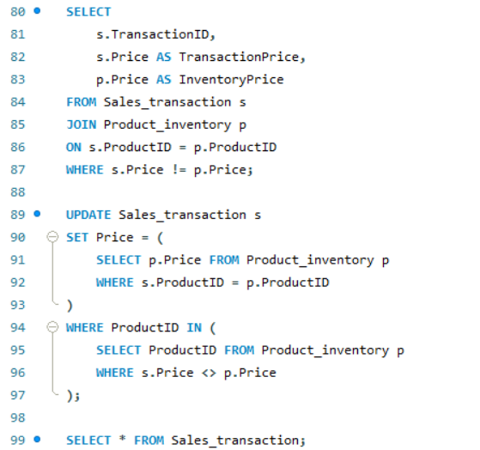
Solution:

Slide 9
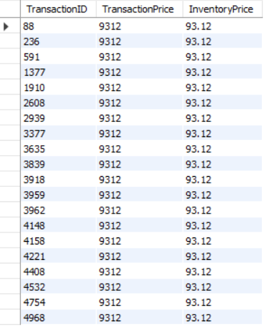
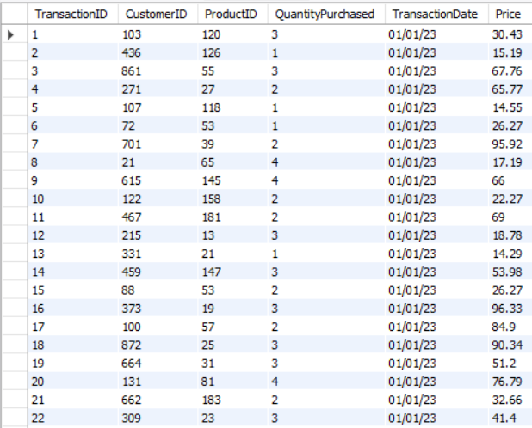
Output:

Slide 10
Insights Drawn:
The solution identifies mismatched prices between sales records and inventory, revealing pricing inconsistencies in the data.
By comparing both tables, it pinpoints transactions with incorrect or outdated prices.
Updating the sales table ensures prices match the accurate inventory values, improving data accuracy.
This prevents errors in revenue, profit, and financial reporting.
The process demonstrates a clear approach to detecting and correcting data inconsistencies.

Slide 11
Problem 3: Fixing Null Values
Write a SQL query to identify the null values in the dataset and replace them with “Unknown”.

Slide 12
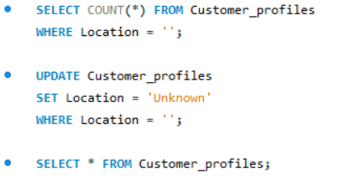
Solution:

Slide 13
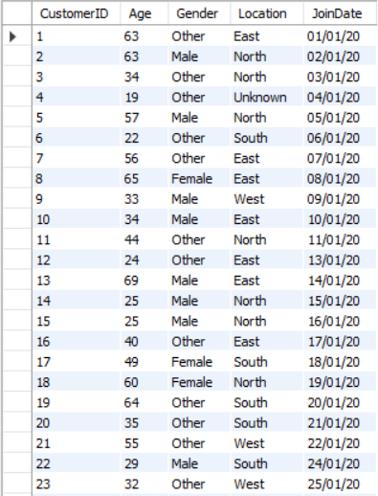
Output:

Slide 14
Insights Drawn:
Identified missing Location values using IS NULL or empty strings.
Replaced all missing entries with “Unknown” to improve data consistency.
Ensures accurate analysis since NULL values can distort counts and groupings.
Standardized missing data helps cleaner reporting and easier querying.
Supports better decision-making by clearly showing how many records lack valid location info.

Slide 15
Problem 4: Cleaning Date
Write a SQL query to clean the DATE column in the dataset.

Slide 16
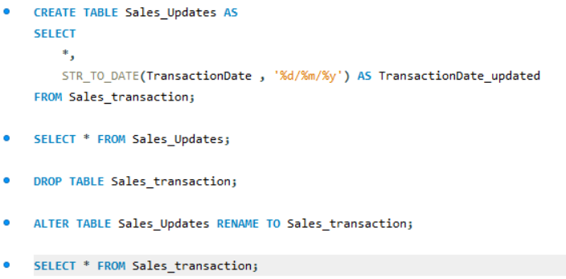
Solution:

Slide 17
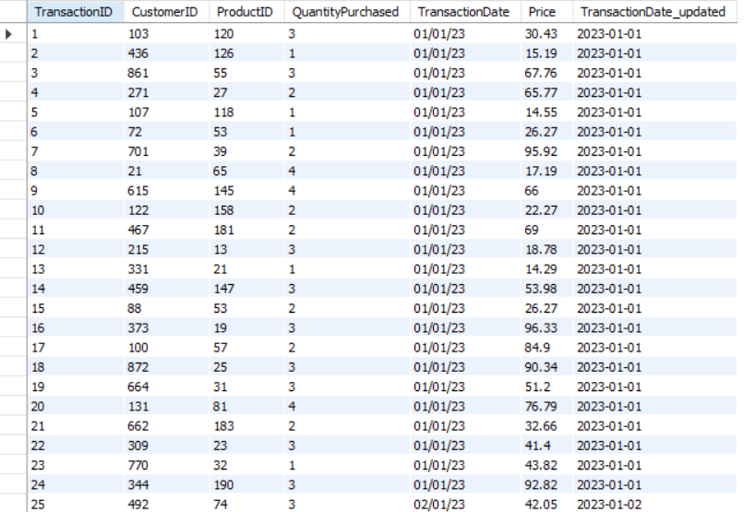
Output:

Slide 18
Insights Drawn:
The query standardizes inconsistent date formats in the TransactionDate column, converting them into a proper SQL date format.
It creates a clean, updated table to avoid corrupting the original dataset during transformation.
After validation, the updated table replaces the old one, ensuring all future analyses use accurate, properly formatted date values.
This improves data quality, reliability, and enables correct time-based analysis, like trends, seasonality, and sales timelines.

Slide 19
Problem 5: Total Sales Summary
Write a SQL query to summarize the total sales and quantities sold per product by the company.

Slide 20
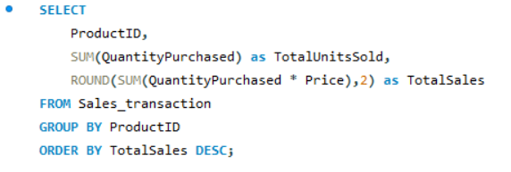
Solution:

Slide 21
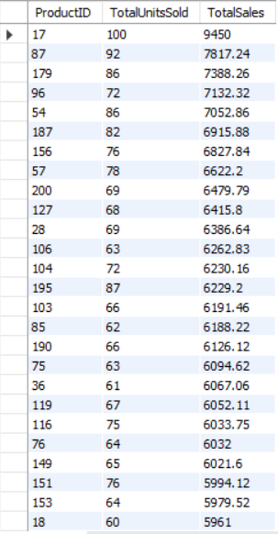
Output:

Slide 22
Insights Drawn:
The query identifies which products drive the highest revenue, helping highlight top-performing items.
It also shows which products sell the most units, revealing high-demand items even if revenue is lower.
Sorting by total sales helps in prioritizing inventory, promotions, and restocking based on financial impact.
Overall, it provides a clear snapshot of product performance, supporting better pricing and product strategy decisions.

Slide 23
Problem 6: Customer Purchase Frequency
Write a SQL query to count the number of transactions per customer to understand purchase frequency.

Slide 24
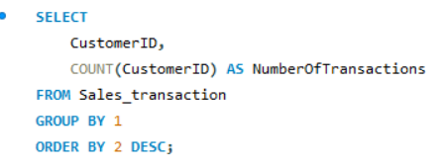
Solution:

Slide 25
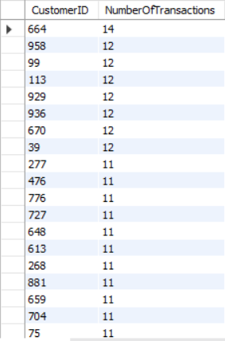
Output:

Slide 26
Insights Drawn:
The query highlights how often each customer purchases, helping identify high-frequency vs. low-frequency buyers.
It enables segmentation into repeat customers, occasional shoppers, and one-time buyers.
The results help target marketing efforts by focusing on loyal customers and creating strategies to improve retention for low-activity customers.
Sorting by transaction count makes it easy to spot the most engaged customers.

Slide 27
Problem 7: Product Categories Performance
Write a SQL query to evaluate the performance of the product categories based on the total sales, which help us understand the product categories which needs to be promoted in the marketing campaigns.

Slide 28
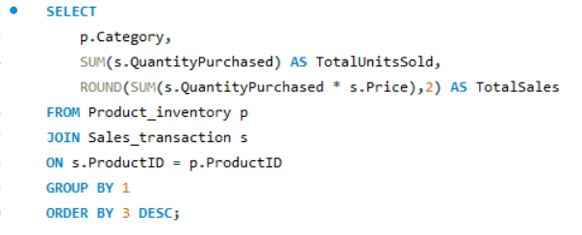
Solution:

Slide 29
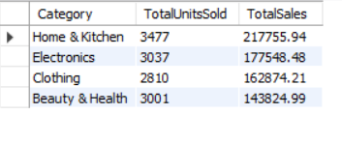
Output:

Slide 30
Insights Drawn:
The query reveals which product categories generate the highest total sales, helping identify top revenue drivers.
It also highlights categories with lower sales, indicating areas that may require marketing support or promotional boosts.
Combining units sold and revenue helps distinguish high-demand categories from those that are high-value but have low volume.
The results guide data-driven marketing decisions, ensuring campaigns focus on categories with the most growth potential.

Slide 31
Problem 8: High Sales Products
Write a SQL query to find the top 10 products with the highest total sales revenue from the sales transactions. This will help the company to identify the high-selling products that need to be focused on to increase the revenue of the company.

Slide 32
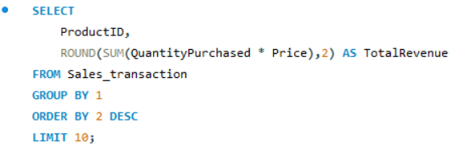
Solution:

Slide 33
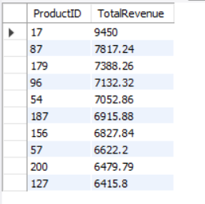
Output:

Slide 34
Insights Drawn:
The query identifies the products that generate the most total revenue, highlighting the key drivers of the company’s sales.
These top-performing products can be prioritized for marketing, promotions, and inventory planning to maximize returns.
The results help the company understand which products have consistently strong demand, allowing for better strategic focus.
Focusing on these high-revenue items can boost overall profitability and support revenue-growth initiatives.

Slide 35
Problem 9: Low Sales Products
Write a SQL query to find the ten products with the least number of units sold from the sales transactions, provided that at least one unit was sold for those products.

Slide 36
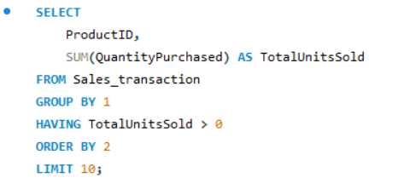
Solution:

Slide 37
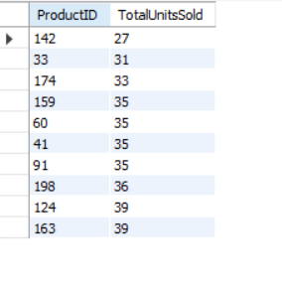
Output:

Slide 38
Insights Drawn:
The query identifies the lowest-selling products, helping pinpoint items with minimal customer demand.
These low-performing products may require improved marketing, repositioning, or potential discontinuation.
The results help optimize inventory by revealing slow-moving or overstocked items.
This insight supports better product-mix decisions and allows the company to focus on higher-performing categories.

Slide 39
Problem 10: Sales Trend
Write a SQL query to identify the sales trend to understand the revenue pattern of the company.

Slide 40
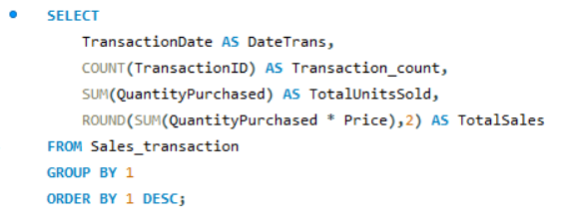
Solution:

Slide 41
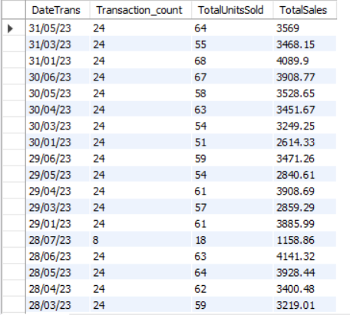
Output:

Slide 42
Insights Drawn:
The query provides a day-wise view of sales performance, including transaction count, total units sold, and total revenue.
It helps identify patterns or fluctuations in daily sales, revealing high and low-performing days.
The results allow the company to understand overall revenue trends and detect any seasonal or periodic variations.
This insight supports better forecasting and planning for marketing, inventory, and staffing based on sales behavior.

Slide 43
Problem 11: Growth Rate of Sales
Write a SQL query to understand the month-on-month growth rate of sales of the company, which will help understand the growth trend of the company.

Slide 44
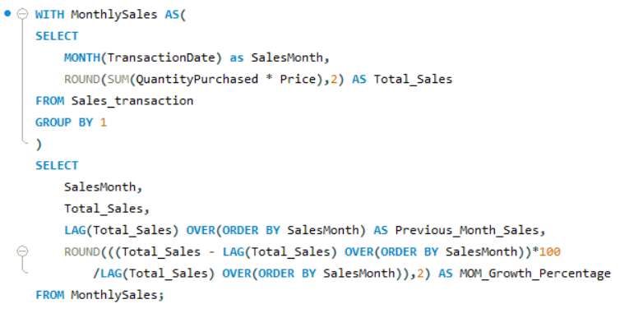
Solution:

Slide 45
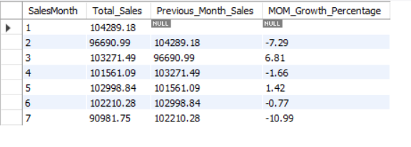
Output:

Slide 46
Insights Drawn:
The query calculates monthly total sales and compares them with the previous month to show growth or decline.
It helps identify positive or negative sales trends, giving a clear view of how revenue is changing over time.
The month-on-month growth rate highlights periods of strong performance as well as months that need attention or improvement.
This insight supports better forecasting, planning, and strategy decisions by tracking the company’s overall growth momentum.

Slide 47
Problem 12: High Purchase Frequency
Write a SQL query that describes the number of transactions along with the total amount spent by each customer who is on the higher side, and will help us understand the customers who make high-frequency purchases in the company.

Slide 48
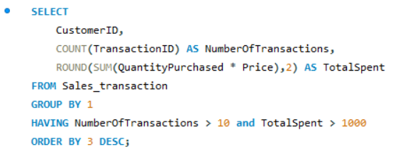
Solution:

Slide 49
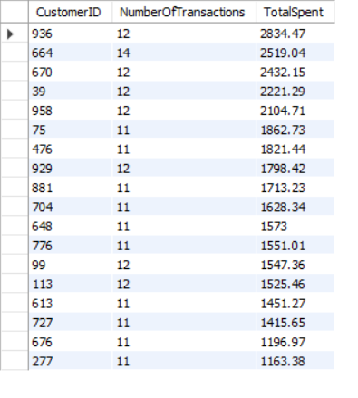
Output:

Slide 50
Insights Drawn:
The query highlights customers who make frequent purchases and have high total spending, identifying the company’s most valuable buyers.
These customers represent a strong loyalty segment and contribute significantly to overall revenue.
Understanding this group helps in designing targeted loyalty programs, personalised offers, and retention strategies.
It also supports prioritizing customer service and engagement efforts for high-value customers.

Slide 51
Problem 13: Occasional Customers
Write a SQL query that describes the number of transactions along with the total amount spent by each customer, which will help us understand the customers who are occasional customers or have low purchase frequency in the company.

Slide 52
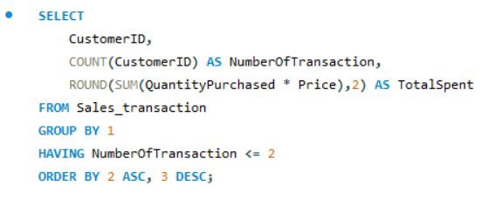
Solution:

Slide 53
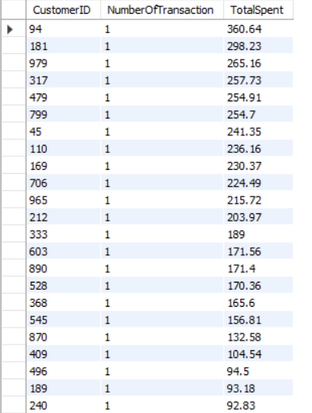
Output:

Slide 54
Insights Drawn:
The query identifies customers who have made only one or two transactions, indicating low purchase frequency.
It helps pinpoint occasional or inactive customers who may require re-engagement.
It shows the total amount spent by these customers, helping assess their revenue contribution.
These insights support the design of targeted marketing efforts to encourage repeat purchases and enhance customer retention.

Slide 55
Problem 14: Repeat Purchases
Write a SQL query that calculates the total number of purchases made by each customer for each productID to identify repeat customers within the company.

Slide 56
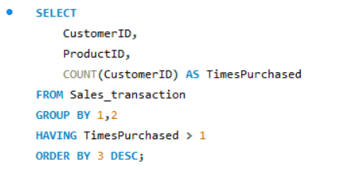
Solution:

Slide 57
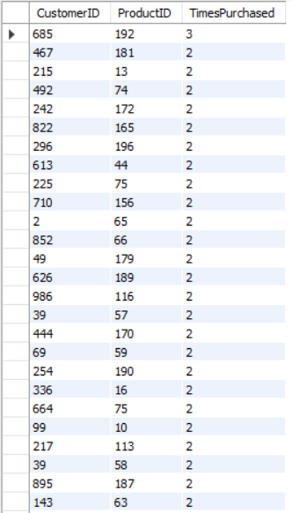
Output:

Slide 58
Insights Drawn:
The query identifies customers who have purchased the same product more than once, showing clear repeat-buying behavior.
It helps recognize loyal and highly engaged customers for specific products.
It highlights which products generate strong repeat demand and customer retention.
These insights help shape targeted upsell, cross-sell, and loyalty strategies for repeat customers.

Slide 59
Problem 15: Loyalty Indicators
Write a SQL query that describes the duration between the first and the last purchase of the customer in that particular company to understand the loyalty of the customer.

Slide 60
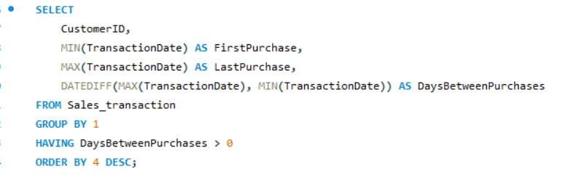
Solution:

Slide 61
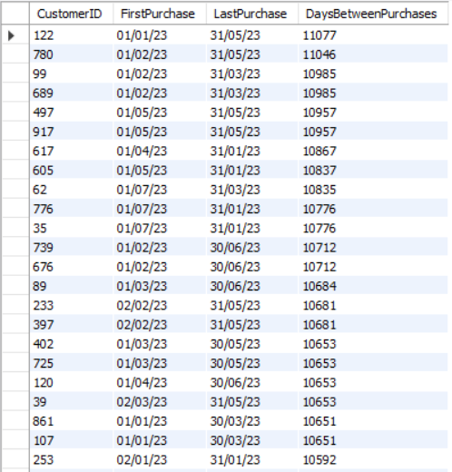
Output:

Slide 62
Insights Drawn:
This query identifies how long each customer has been purchasing from the company by calculating the time between their first and last transactions.
It helps determine which customers show strong loyalty by maintaining a long and consistent purchasing relationship.
It also highlights customers with shorter engagement periods, allowing the company to assess potential churn risk and take action to improve retention.

Slide 63
Problem 16: Customer Segmentation
Write an SQL query that segments customers based on the total quantity of products they have purchased. Also, count the number of customers in each segment, which will help us target a particular segment for marketing.

Slide 64
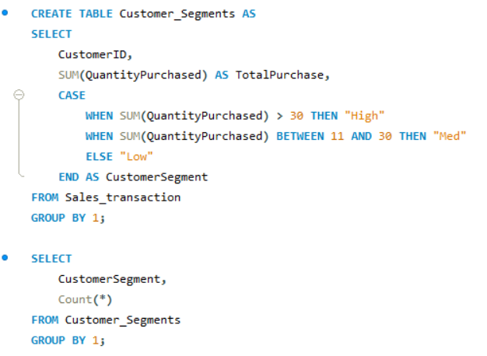
Solution:

Slide 65
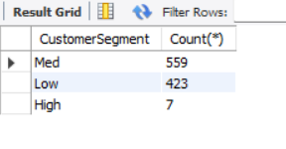
Output:

Slide 66
Insights Drawn:
The query segments customers into High, Medium, and Low purchase groups based on the total quantity they have bought.
It helps identify which customer segment is the largest, showing where most customers fall.
It highlights high-value customers who purchase the most and may need premium or loyalty-focused marketing.
It also identifies low-purchase customers, useful for re-engagement or targeted promotional campaigns.

Slide 67
THANK YOU!
ANKITA DUTTA
Email ID: duttankita.17@gmail.com
Mobile No.: 8013691874

